Slide 1

SCALA

Slide 2
Contents
Scala Collections
List/Set/Map
Filtering & Transformation
FlatMap
Method Notations
Inheritance

Slide 3
Collections
Scala has a rich set of collection library.
Collections are containers of things. Those containers can be sequenced, linear sets of items like List, Tuple, Option, Map, etc.
The collections may have an arbitrary number of elements or be bounded to zero or one element (e.g., Option).
Collections may be strict or lazy. Lazy collections have elements that may not consume memory until they are accessed, like Ranges.

Slide 4
Additionally, collections may be mutable (the contents of the reference can change) or immutable (the thing that a reference refers to is never changed). Note that immutable collections may contain mutable items.
For some problems, mutable collections work better, and for others, immutable collections work better. When in doubt, it is better to start with an immutable collection and change it later if you need mutable ones.
This chapter throws light on the most commonly used collection types and most frequently used operations over those collections.

Slide 5
Collections with Description
Scala Lists
Scala's List[T] is a linked list of type T.
Scala Sets
A set is a collection of pairwise different elements of the same type.
Scala Maps
A Map is a collection of key/value pairs. Any value can be retrieved based on its key.

Slide 6
Scala Tuples
Unlike an array or list, a tuple can hold objects with different types.
Scala Options
Option provides a container for zero or one element of a given type.
Scala Iterators
An iterator is not a collection, but rather a way to access the elements of a collection one by one.

Slide 7
Lists
Lists in Scala are always immutable they are designed to enable a functional style programming.
That means that, once created, a Scala List can’t be modified.
But there are operators on Lists, so maybe you would be wondering why there are operators on Lists if they are immutable objects.
As in Strings, when you invoke any operation on a List, another List is created and returned when an operator is applied.

Slide 8
Maybe, the two main operators are ::: and :: .
The first one is the operator for list concatenation.
The second one is the operator to prepend an element to a List. Yes, you read it well: prepend (in Scala you can’t append elements to a list).
This is because prepend an element at the beginning of a list is a constant-time operation, whereas append is a linear-time operation.
Usually, the owner of an operation is the left operand, but in :: the owner is the right operand. Here there are some examples.

Slide 9
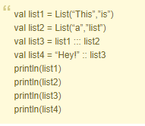
List1 and list2 remain immutable, they didn’t change. List3 is a new list resulting of concatenating list1 and list2. In list4, the String “Hey!” is prepended to list3.

Slide 10
Sets
There are two kinds of Sets, the immutable and the mutable one.
The difference between mutable and immutable objects is that when an object is immutable, the object itself can’t be changed.
The most known immutable object in Java is String: once you have created a String, it remains the same until it is destroyed.

Slide 11
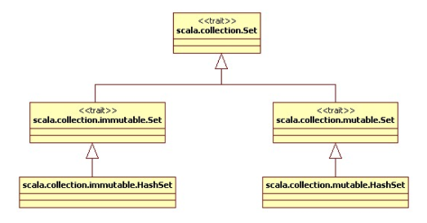
By default, Scala uses the immutable Set.
If you want to use the mutable Set, you’ll have to import the class. The hierarchy of the Set is the following:

Slide 12
It’s not a problem to change between mutable and immutable collections, since all of them share the same contract.
In most cases, no change will be necessary.
You can create a Set in the same way you create a List.
The most useful operations are + and +=, but the second one it’s only available in mutable Sets.

Slide 13

In the immutable Sets mySet += “foo” is transformed to mySet = mySet.+(“foo”).
Here there is a simple example of immutable sets:

Slide 14

In this example, a new Set is created in line 2.
If we import the mutable Set, in this same line, the trilogies set will be modified:

Slide 15
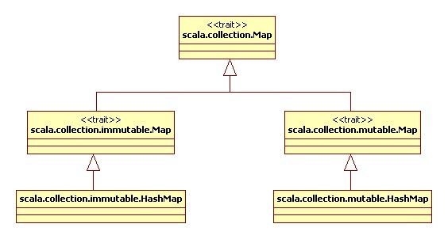
Maps
As in Sets, there are two kinds of Maps, the immutable and the mutable ones.
The hierarchy of Map is analog to Map’s hierarchy:

Slide 16
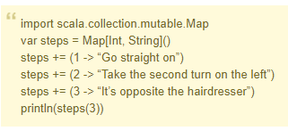
There are two ways to create a Map in Scala, one of them can only be used with the mutable Maps:

Slide 17

Obviously, this Map needs to be mutable, because it has been modified since its creation. Ok, we know how to create mutable Maps, but how immutable Maps can be created?

Slide 18
Here again, there is no need to specify the type of the Array, the compiler will infer that the type is Int for the keys and String for the values.
The operator -> is useful for creating Tuples.
A Tuple can be seen as an array of objects, but they don’t need to share the same type.

Slide 19
Filter
The filter() method is utilized to select all elements of the list which satisfies a stated predicate.
Method Definition: def filter(p: (A) => Boolean): List[A]
Return Type: It returns a new list consisting all the elements of the list which satisfies the given predicate.

Slide 20
Transform
The transform() method is utilized to transform the elements of the map into a mutable map.
Method Definition: def transform(f: (K, V) => V): Map.this.type
Return Type: It transforms all the elements of the map and returns them into a mutable map.

Slide 21
FlatMap
In Scala, flatMap() method is identical to the map() method, but the only difference is that in flatMap the inner grouping of an item is removed and a sequence is generated.
It can be defined as a blend of map method and flatten method.
The output obtained by running the map method followed by the flatten method is same as obtained by the flatMap().
So, we can say that flatMap first runs the map method and then the flatten method to generate the desired result.

Slide 22
It has a built-in Option class as an Option can be expressed as a sequence which has at most one element i.e, either its empty or has only one element.
The flatten() method is utilized to disintegrate the elements of a Scala collection in order to construct a single collection with the elements of similar type.

Slide 23
Inheritance
When a class inherits from another, it means it extends another. We use the ‘extends’ keyword for this.
This lets a class inherit members from the one it extends and lets us reuse code.
The class that extends is the subclass, the child class, or the derived class.
The other class is the superclass, the parent class, or the base class.

Slide 24
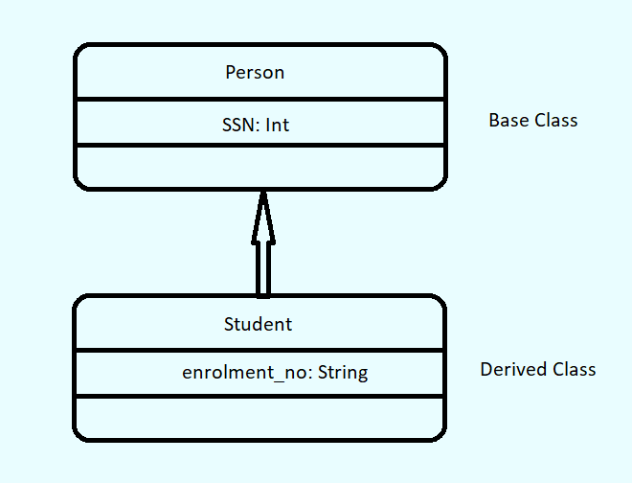
It is an IS-A relationship. You can also call it a generalization. A Student is a Person

Slide 25

syntax
To carry out Scala inheritance, we use the keyword ‘extends’:

Slide 26
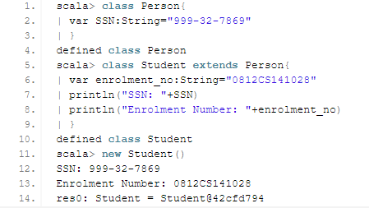
Example
Let’s take an example of Inheritance.

Slide 27
In this example, we have two classes- Person and Student.
We make Student extend Person. This means a Student is a Person.
Since Student extends Person, it inherits the attribute holding the social security number.
In class Student, we print SSN and enrolment_no. Finally, we create an object of class Student.

Slide 28
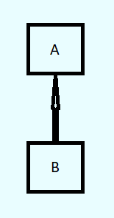
Types of Inheritance
Single-level Inheritance
Scala Single-level inheritance is when one class inherits from a single other class.

Slide 29
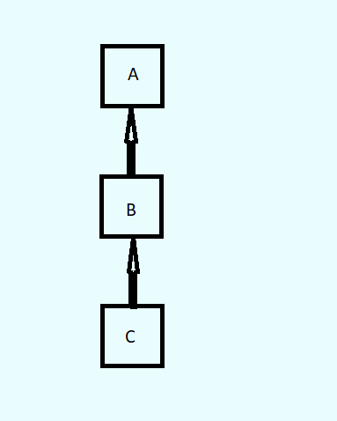
2. Multilevel Inheritance
When one class extends another, which in turn extends another, it is an instance of multilevel inheritance.

Slide 30
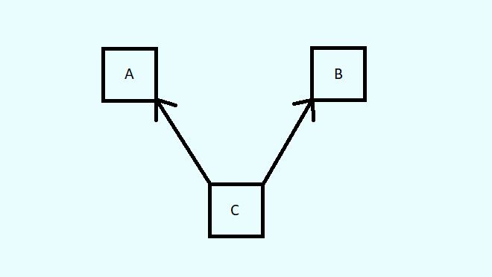
3. Multiple Inheritance
When one class inherits from multiple base classes, it is a case of multiple inheritances.

Slide 31
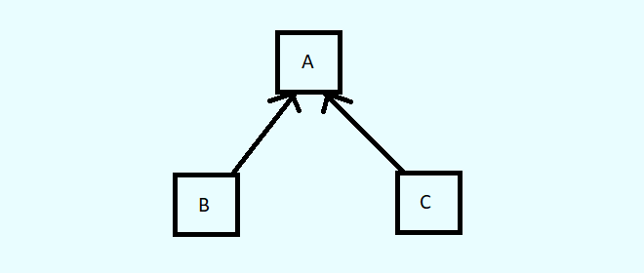
4. Hierarchical Inheritance
When more than one class inherits from one base class, it is said to be hierarchical inheritance.

Slide 32
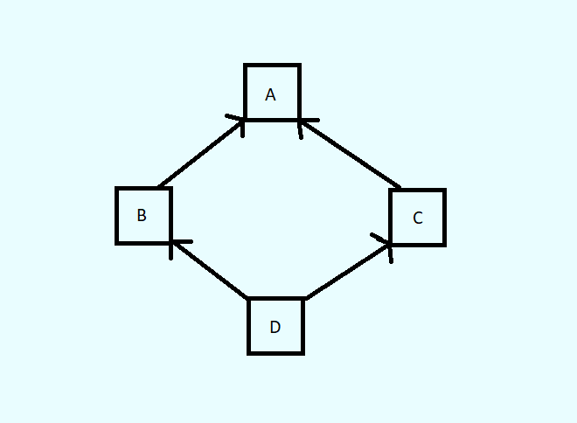
5. Hybrid Inheritance
Scala Hybrid inheritance is a combination of at least two kinds of inheritance.

Slide 33
THANK YOU

